Slide 1
HOW TO WRITE YOUR NAME IN MATH
CONTINUED ON SLIDE 2
Aug 27: Initial Content Burst
Video 8: https://youtu.be/LS1e4TqXrRE
Questions 1. Why should anyone care?
2. Must functions always pass the vertical line test?
3. Where the heck did those fractions come from?
4. What did Gary do?
5. Am I meant to know my equations of curves?
6. Can I do piece-wise stuff?
7. Can you use geometric constructions to write your name?
8. What data could I use to create a given scatter plot?
9. Can I do this with my graphing calculator?
10. What’s this obsession with xs and ys?
Video 9: https://youtu.be/Fr0iQgrh8Lg
https://globalmathproject.org/personal-polynomial/
Top vote (3 votes)
Top vote (4 votes)
Top vote (4 votes)
CONTINUED
ON SLIDE 3
Video 10: https://youtu.be/-MN3Yv1EdsM

Slide 2
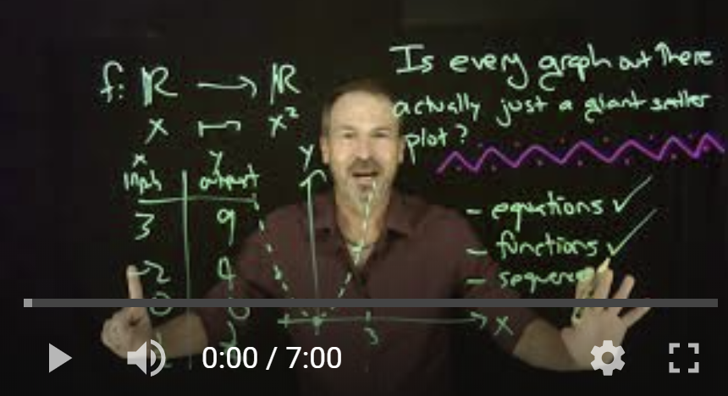
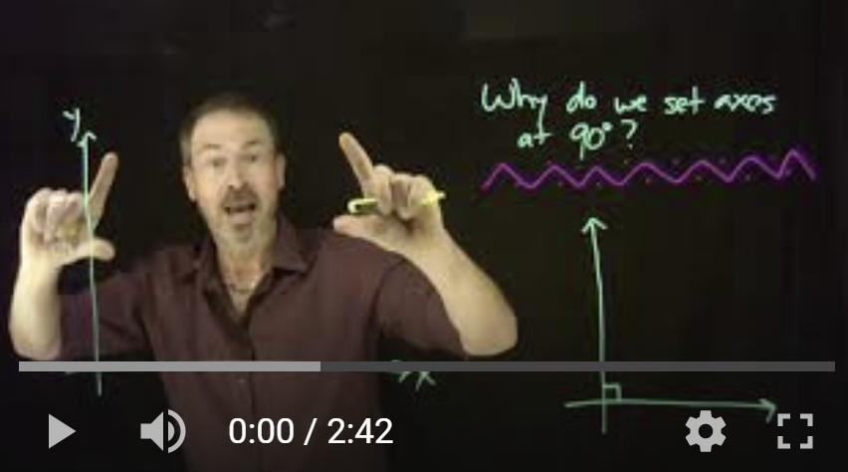
Question 8: What data could I use to create a given scatter plot?
Questions in response to the response video: https://youtu.be/LS1e4TqXrRE
https://youtu.be/zvDN55fULKA
8.1 Is every graph out there actually just a giant scatter plot?
8.2 Why do we choose 90 degrees for axes in the coordinate plane?
8.3 Is it possible to add a z-axis to a scatter plot?
8.4 If axes don’t have to be 90 degrees, is there a real-life example?
https://youtu.be/2VLJIw-RvGU

Slide 3
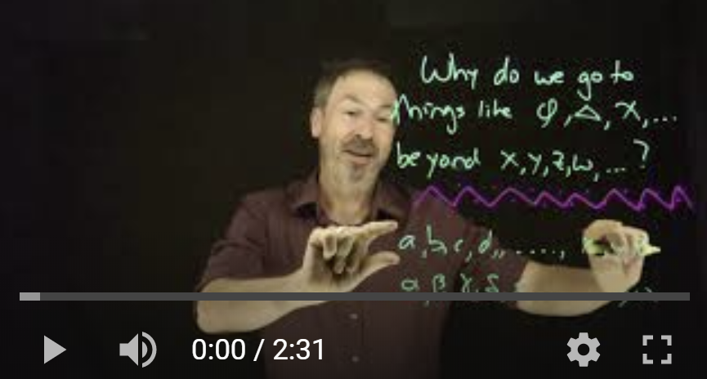
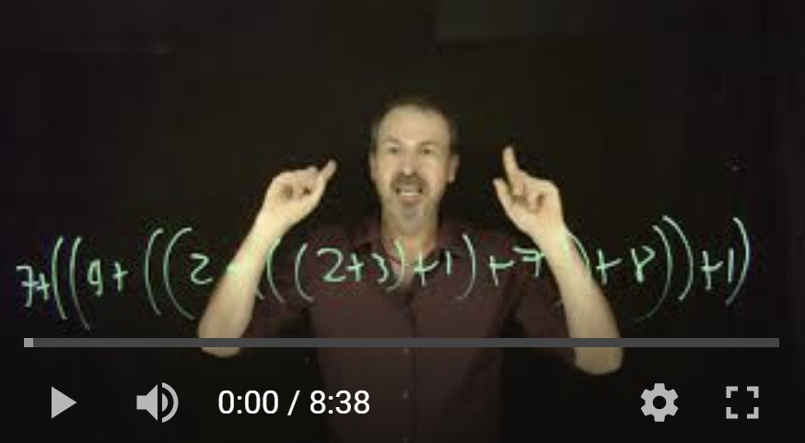
Question 10: What’s this obsession with xs and ys?
Questions in response to the response video: https://youtu.be/-MN3Yv1EdsM
https://youtu.be/9yNfikH4LpQ
10.1 Why did we use things like $φ, ∆, χ$and why did we transition from x,y,z to these?
10.2 How was PEMDAS created?
10.3 How are math conventions created in general?
10.4 Why do we unconsciously solve stuff?
10.5 Why does everyone think that Mr Moneybags in Monopoly have a monocle?
https://youtu.be/7xEsMah8vwc

Slide 4
8.1 QUESTIONS
** Are Equations and Functions the same thing? (This was your question asked)
So my thinking when you asked that was no. That's because not every equation is a function. For example, y^2 = x. It would not pass the vertical line test because there can be two outputs for the same input.
This is also the same for things like ellipses too.
So rather than asking are they the same, I'd like the ask the following: Why are we obsessed with equations always having to be functions?
** Another question because I love 3-D graphing: Is there an equation that is a function on a 2-D plane that isn't a function in a 3-D plane?
** Why aren't we teaching students about 3-D planes in high school? Wouldn't it give them a better understanding of solid shapes in geometry?

Slide 5
8.2 QUESTIONS

Slide 6
10.1 QUESTIONS

Slide 7
10.3 QUESTIONS
** Vinculum: Is it the same line we use to give segment notation? My main thought of this is that maybe it stems from all the points can be individually grouped into a segment. Then, adding the arrows at the end for a line makes the vinculum continuous.
(Side comment: Math history is so cool and amazing. Though, learning the print pressing solidified my statement that mathematicians are lazy haha!)

