Slide 1
A LITTLE SOMETHING ABOUT
DOTS AND DASHES
James Tanton
MAA Mathematician-at-Large
jtanton@maa.org
Curriculum Inspirations: www.maa.org/ci
Mathematical Stuff: www.jamestanton.com
Mathematical Courses: www.gdaymath.com

Slide 2
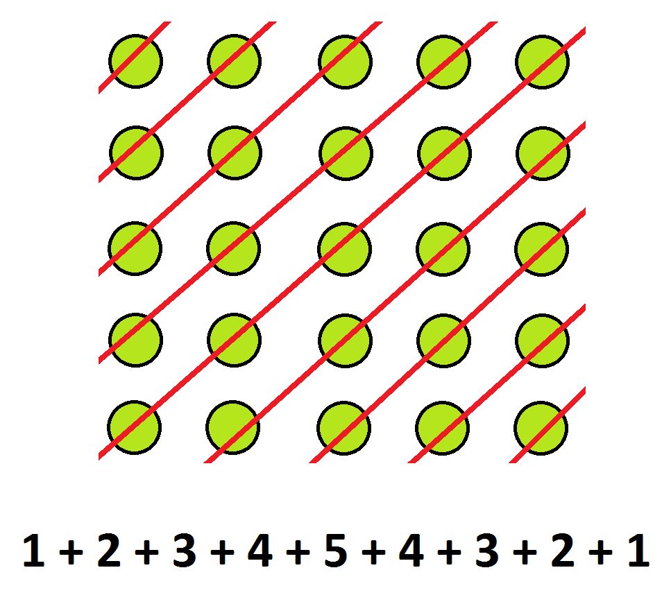
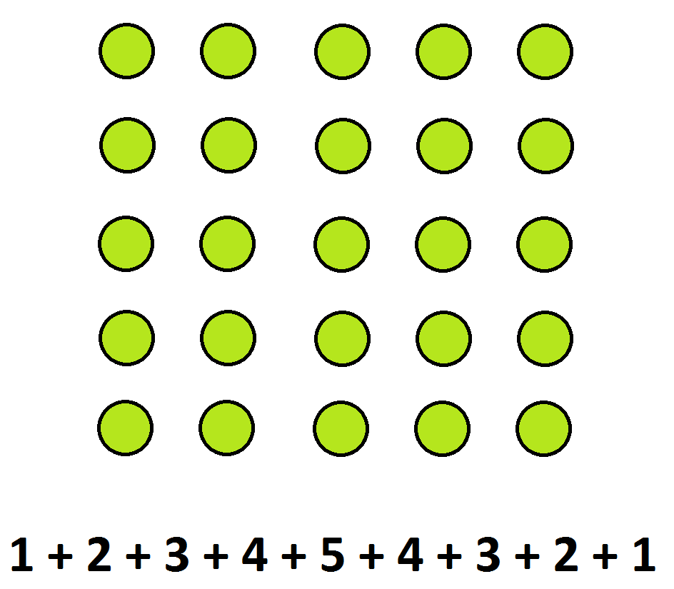

Slide 4
Visualization in the curriculum
* “Visual” or “Visualization” appears 34 times in the ninety-three
pages of the U.S. Common Cores State Standards
- 22 times in reference to grade 2-6 students using visual models for fractions
- 1 time in grade 2 re comparing shapes
- 5 times re representing data in statistics and modeling
- 4 times re graphing functions and interpreting features of graphs
- 2 times in geometry re visualizing relationships between two- and three-dimensional objects.
* Alberta curriculum: Recognised HS core mathematical process:
[V] Visualization “involves thinking in pictures and images, and the ability to perceive, transform and recreate different aspects of the world” (Armstrong, 1993, p. 10). The use of visualization in the study of mathematics provides students with opportunities to understand mathematical concepts and make connections among them.

Slide 5
The sequence of Fibonacci numbers
possesses a number of remarkable properties, including:
BUT WAIT! More is true

Slide 6
Add 1 to the first term of each of {F_{n}} and {G_{n}},
add 2 to the second term of each of {F_{n}} and {G_{n}},
add 3 to the third term of each, and so on.
We obtain complementary sequences.

Slide 7
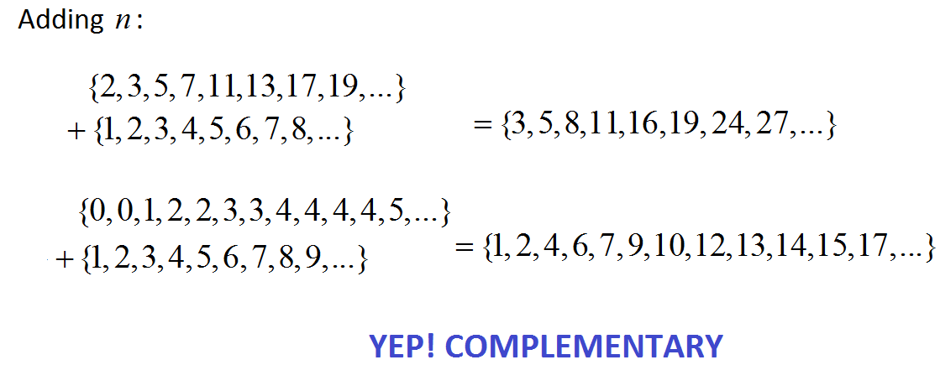
The sequence of prime numbers has these properties too!

Slide 8
So too does this sequence I just made up!

Slide 9
The following result is well known.
Visual proof with three high school students:
E. Rudyak, J.S. You, C. Zodda

Slide 11
Further …

Slide 12
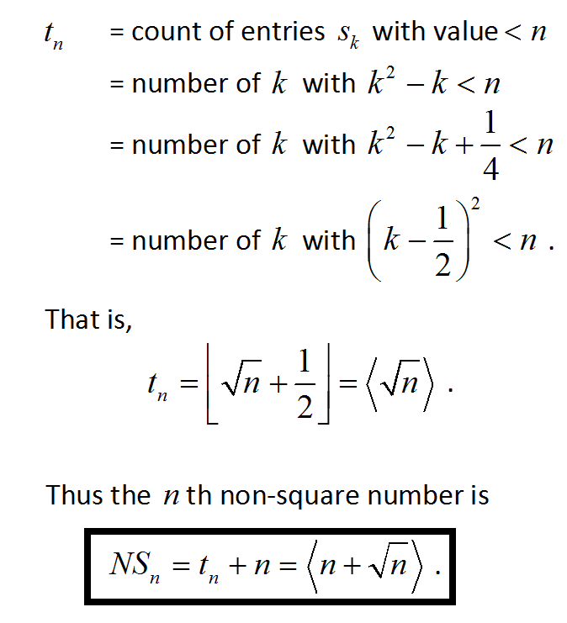
A typical application:

Slide 13
In the same way we establish:
I can’t help but ask …

Slide 14
Natural Next Questions:

Slide 15
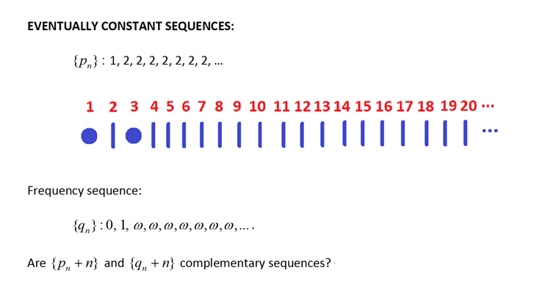
Here ω is Cantor’s first transfinite ordinal.
(By the way, 1 + ω = ω is different from ω + 1.)

Slide 16
More fun thinking …

Slide 17
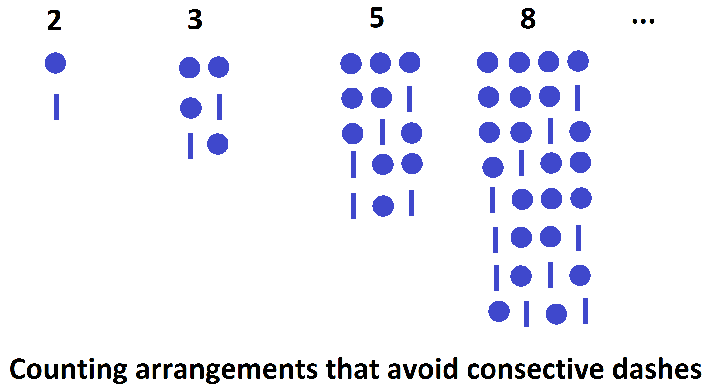
While we have some time …
The Fibonacci numbers arise in pictures of dots and dashes as follows:

Slide 18
Curve the dashes and make parentheses.
Count how many ways to arrange non-nested parentheses.
Every second Fibonacci number?
WHY YES!

Slide 19
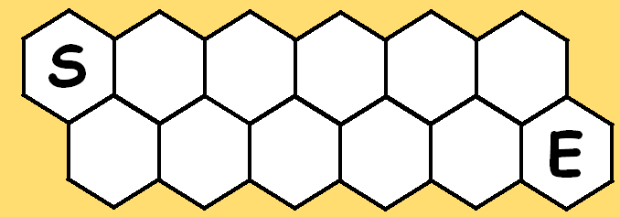
1, 1, 2, 3, 5, 8, 13, 21, 34, 55, 89, 144, …
The Fibonacci numbers arise from a classic honeycomb path-counting puzzle:

Slide 21
The “second Fibonacci numbers” we saw for non-nested parentheses are the numbers on the top row.
Each path to a cell on the top row dictates which dots on the bottom row to place in parentheses, and vice versa.

Slide 22
A ridiculously large number of Fibonacci properties can be explained
with this visual.
The count of ways to partition a number into 1s and 2s is Fibonacci.

Slide 23
Count the ordered partitions of a number with two different types of 1.
1 = 1 2 partitions
2 = 1 + 1 = 1 + 1 = 1 + 1 = 1 + 1 5 partitions
3 = 2 + 1 = 2 + 1 = 1 + 2 = 1 + 2
= 1+1+1 = 1+1+1 = 1+1+1 = 1+1+1 = 1+1+1 = 1+1+1 = 1+1+1 = 1+1+1 13 partitions
Every second Fibonacci number!

Slide 24
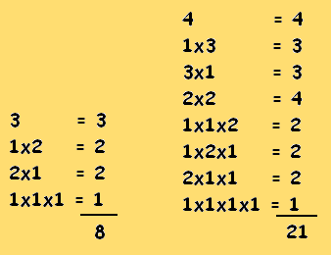
A challenge for you:
Take all partitions of a given number, multiply terms, and add:
ALWAYS FIBONACCI!

Slide 25
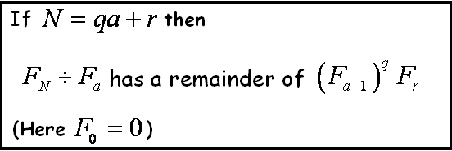
Prove famous Fibonacci formulas.
My favourite:
Even find a formula for the quotient:
Deal with remainders too!

Slide 26
Weeks of fun to be had all with the POWER OF A PICTURE!
THANK YOU!

Slide 27
A LITTLE SOMETHING ABOUT
DOTS AND DASHES
James Tanton
MAA Mathematician-at-Large
jtanton@maa.org
Curriculum Inspirations: www.maa.org/ci
Mathematical Stuff: www.jamestanton.com
Mathematical Courses: www.gdaymath.com

