Slide 1
100 PROBLEMS INVOLVING
THE NUMBER 100
James Tanton
MAA Mathematician-at-Large
jtanton@maa.org
Curriculum Inspirations: www.maa.org/ci
Mathematical Stuff: www.jamestanton.com
Mathematical Courses: www.gdaymath.com

Slide 4
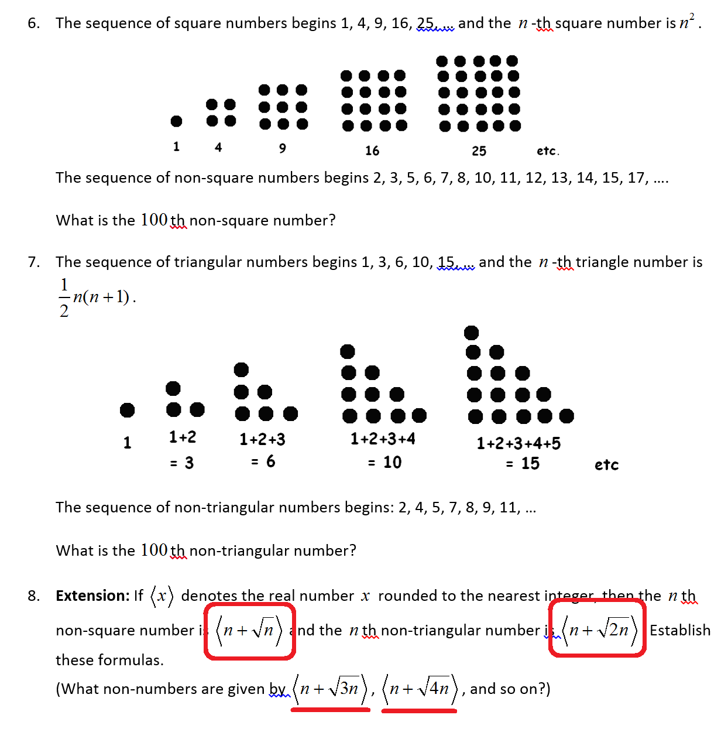

Slide 5
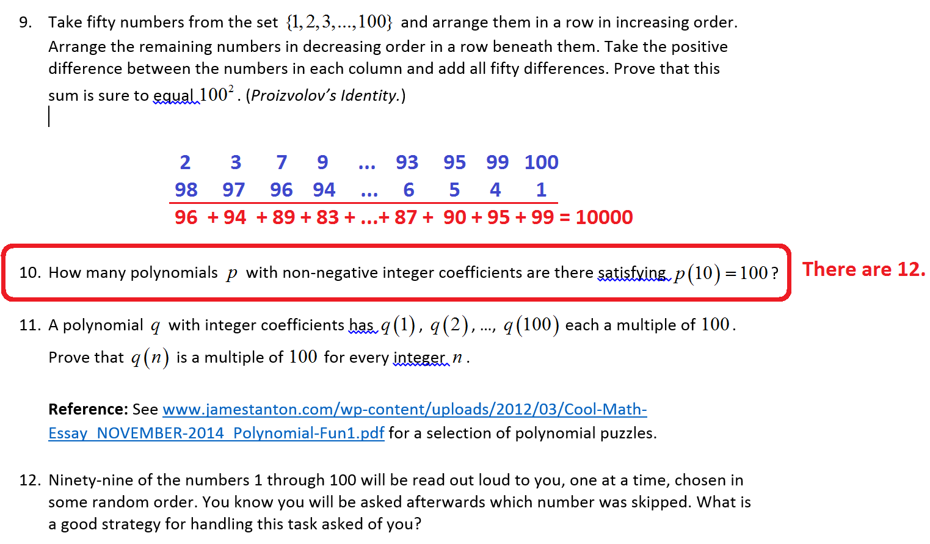

Slide 6
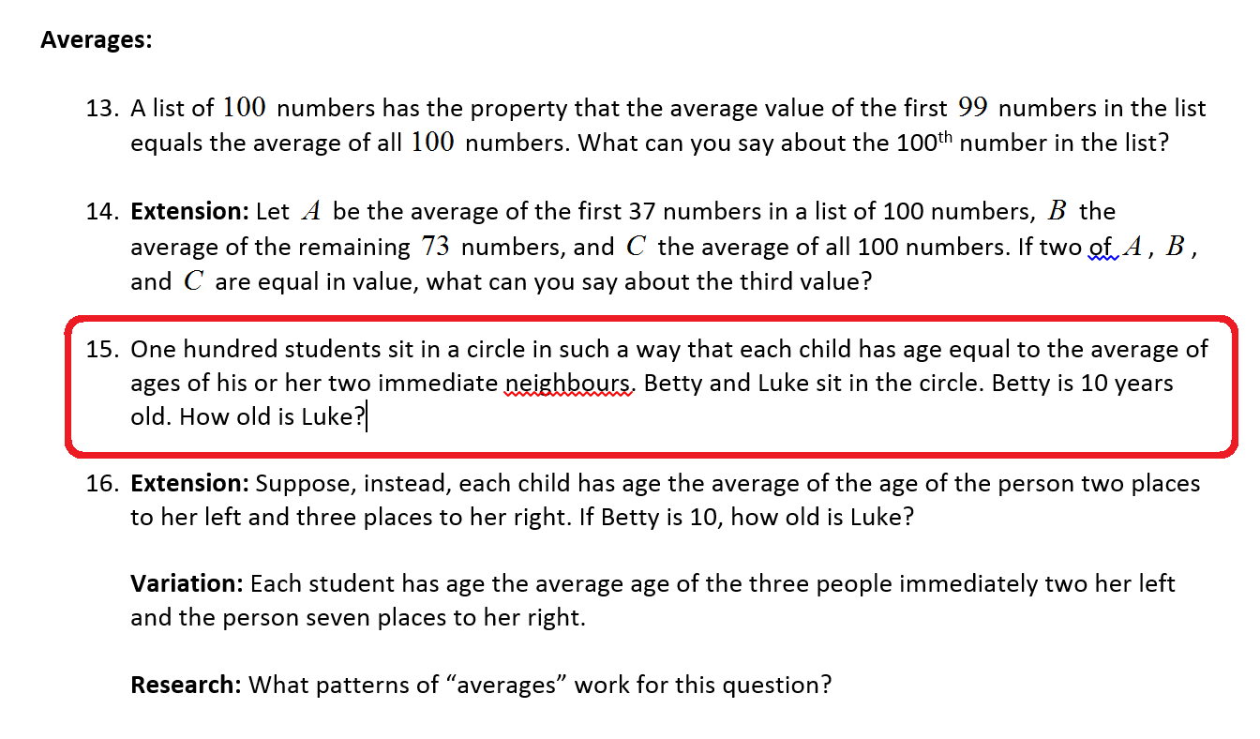

Slide 8
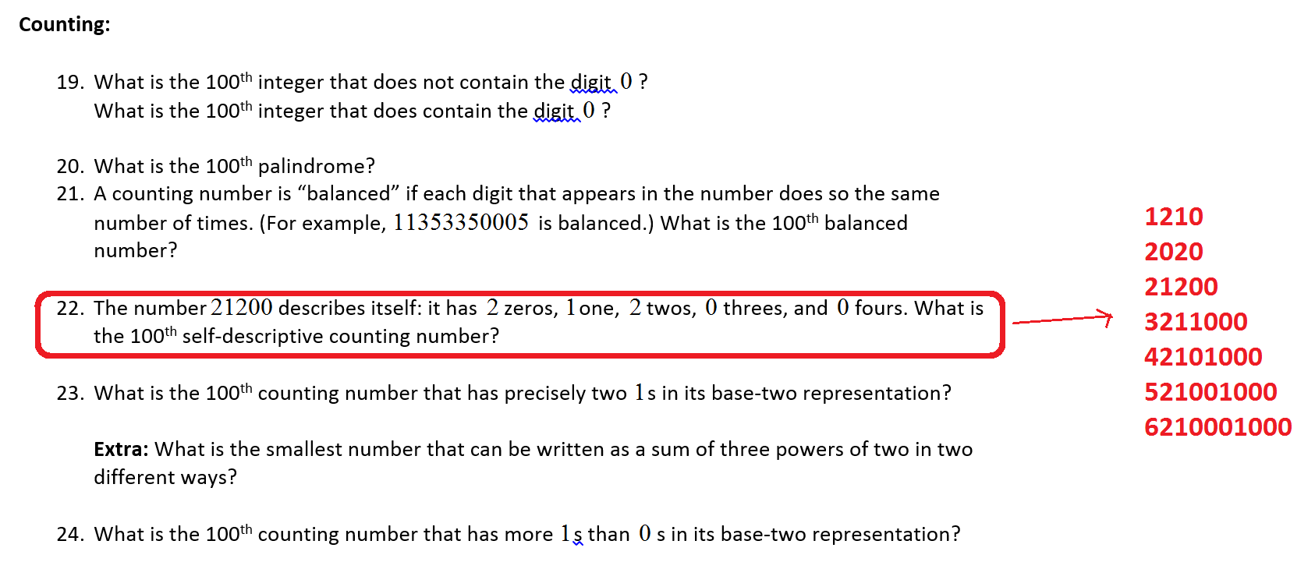

Slide 16
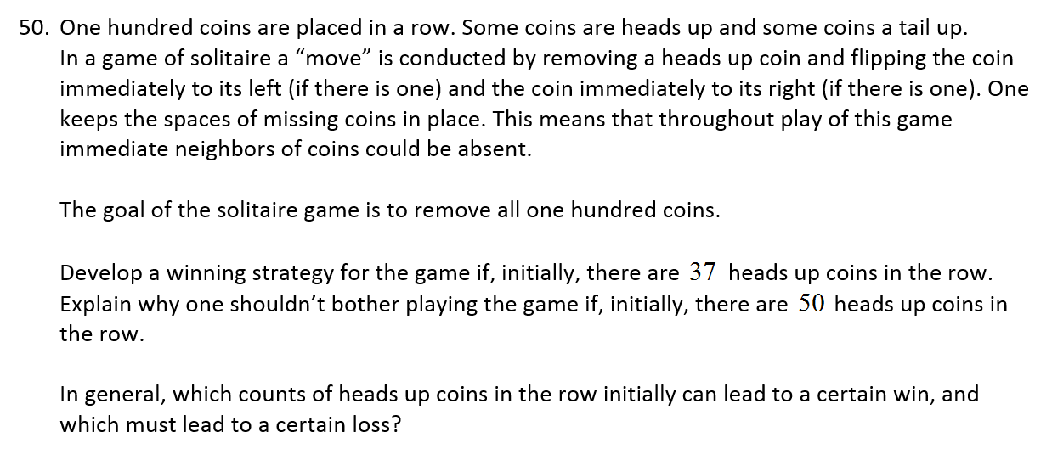

Slide 18
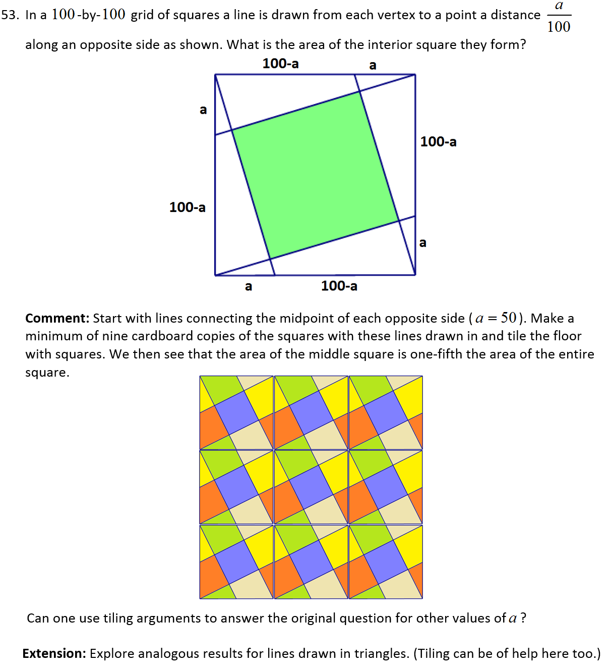

Slide 19
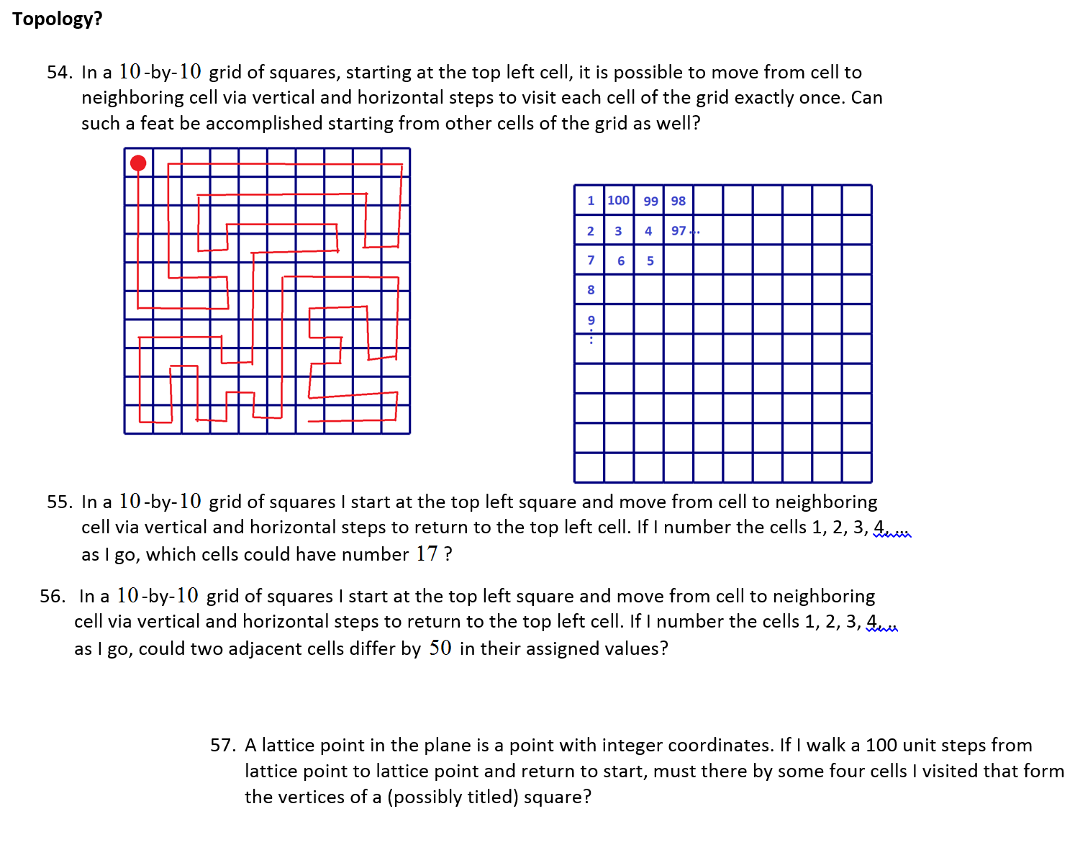

Slide 21
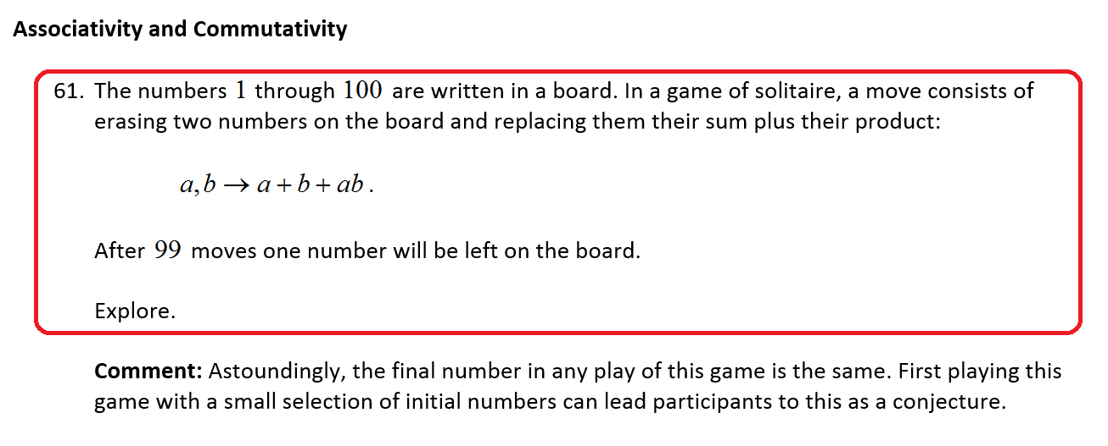
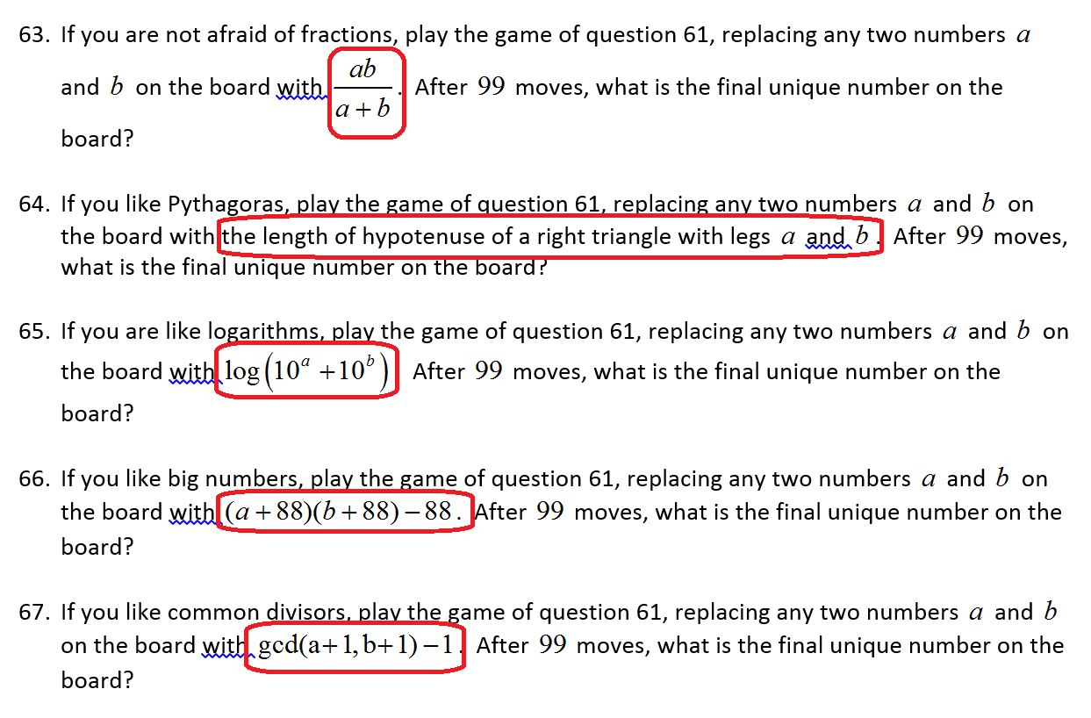

Slide 29
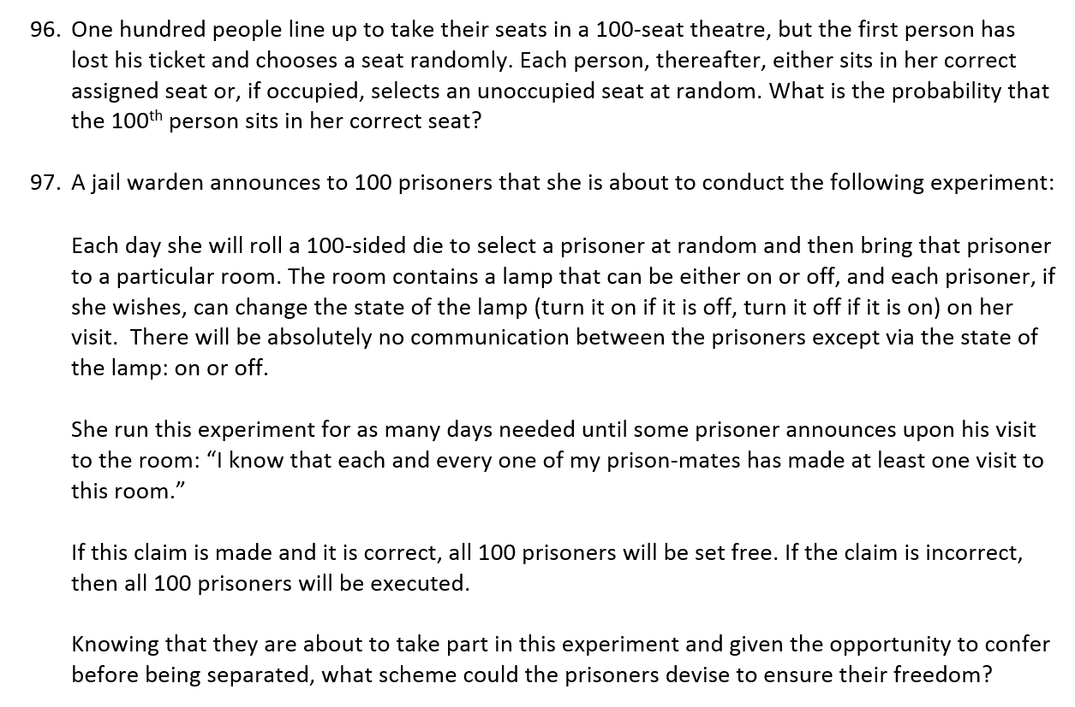

Slide 30
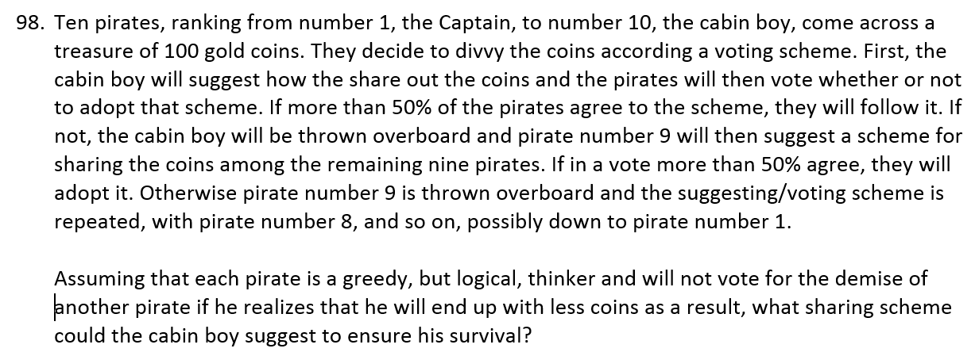

Slide 31
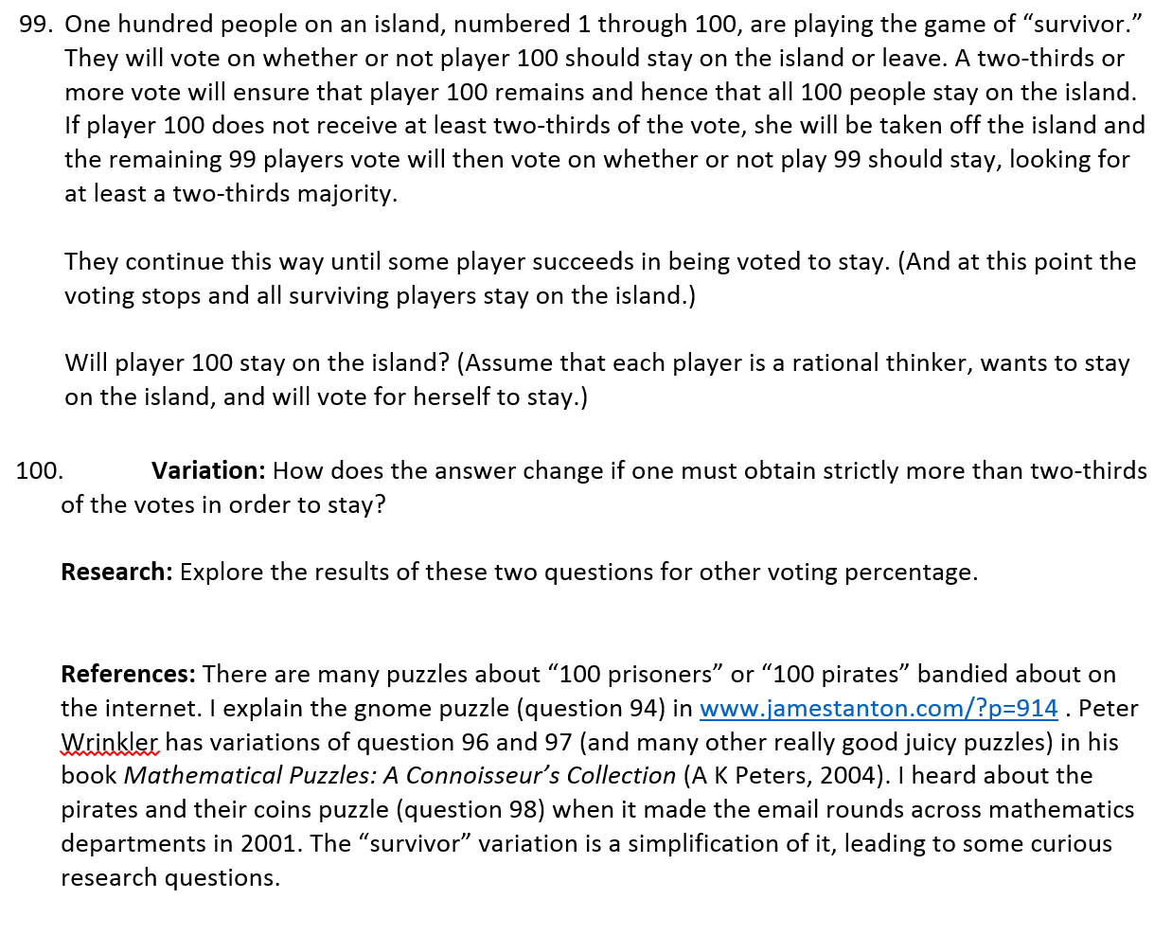
DONE!

