Slide 1
THE POWER OF AREA
James Tanton
Mathematical Association of America

Slide 2
Before we begin …
Have you seen this weird way to multiply?
e.g. 21 x 32
2
1
3
6
2
21 x 32 = 672
7
2

Slide 3
e.g. 331 x 12
3
3
1
1
3
2
9
2
331 x 12 = 3972
7
Some people prefer to draw their diagrams turned 45 degrees.

Slide 4
YOUR TURN… 341 x 23 (This one has an issue.)
3
4
1
2
6
7
3
17
7
14
3
8
341 x 23 = 7843
4

Slide 5
102 x 31
YOUR TURN AGAIN (and another issue):
1
0
2
3
3
0
6
3
1
1
0
2
1
6
2
102 x 31 = 3162

Slide 6
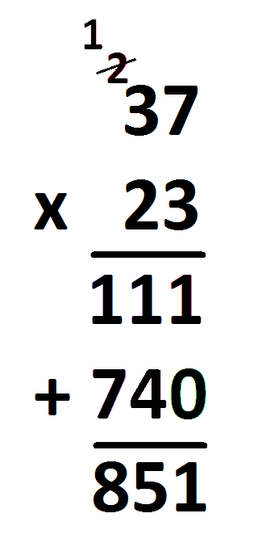
Here’s another weird multiplication algorithm:
e.g. 37 x 23
Weird things:
Right to Left
Not allowed to write 21
Are allowed to write 11
Where 11 is written is weird
Throw in a zero
Not allowed to write 14
Where you write 4 and 7
End with an addition problem!

Slide 7
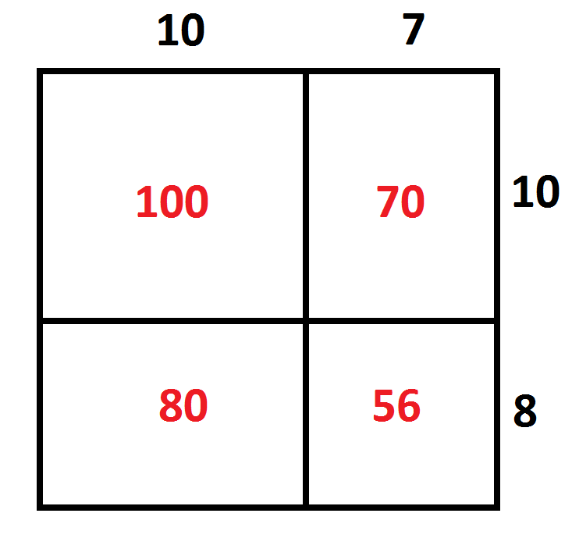
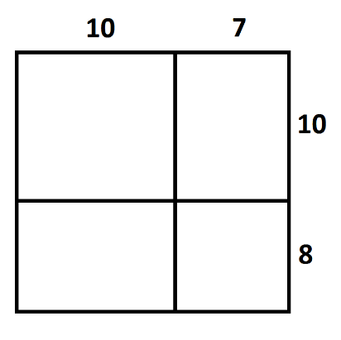
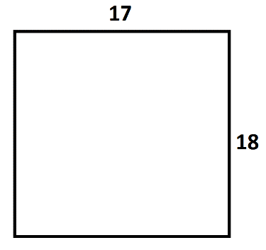
What is multiplication really?
e.g. 17 x 18
17 x 18 = 100 + 70 + 80 + 56 = 306

Slide 8
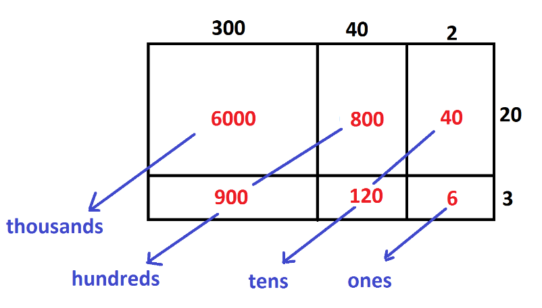
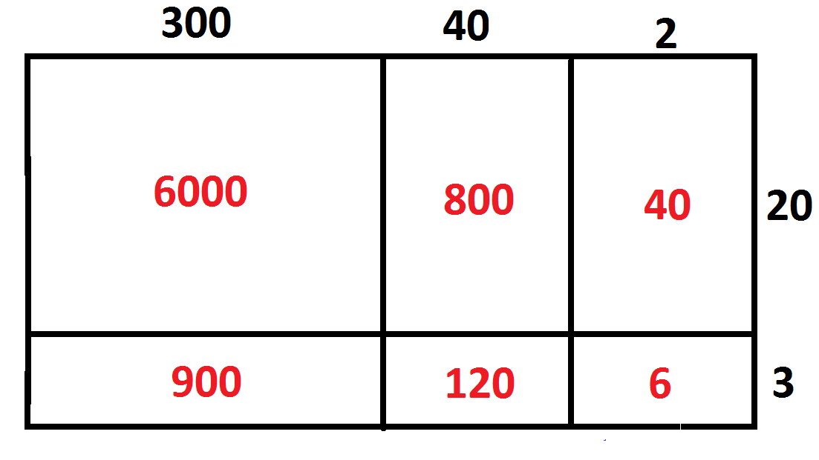
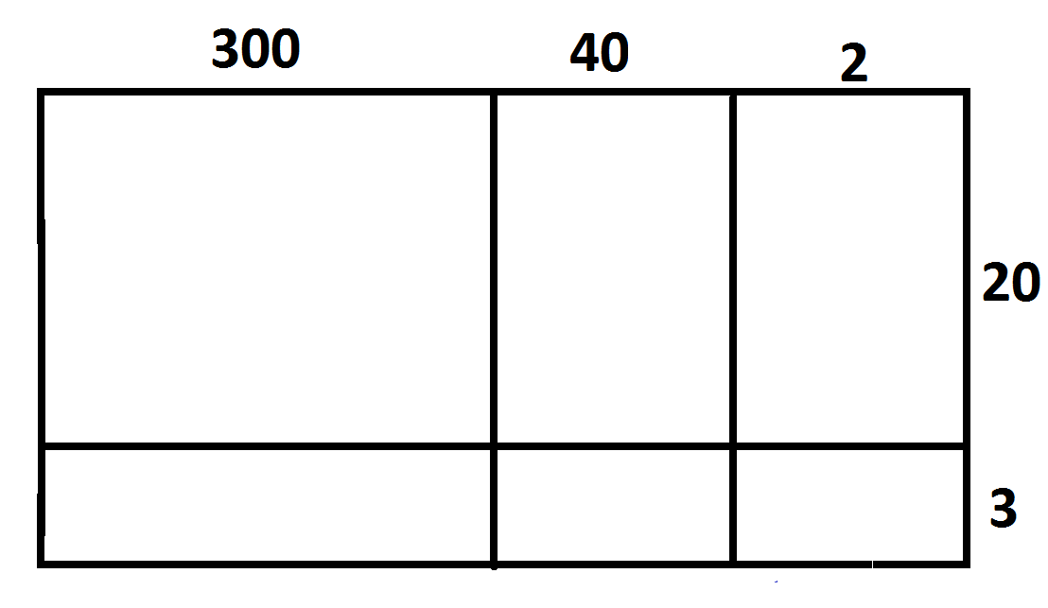
e.g. 342 x 23
342 x 23 = 6000 + 1700 + 160 + 6 = 7866

Slide 9
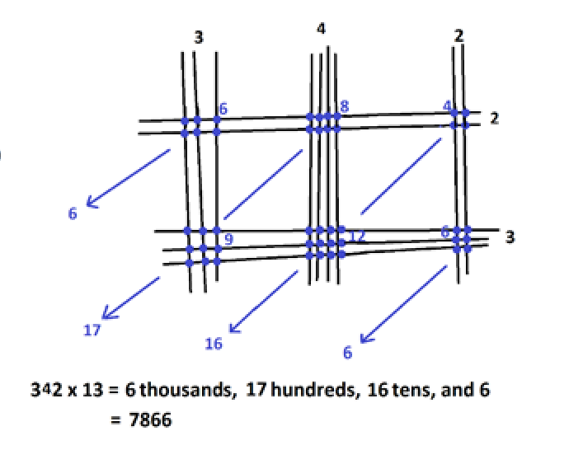
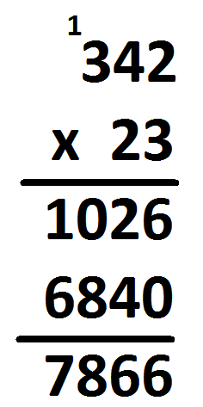
342 x 23 = 6000 + 1700 + 160 + 6
= 7866
All approaches are the
same geometry in disguise!
And that geometry is area.

Slide 10
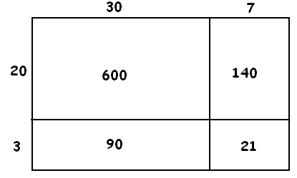
EXPANDING BRACKETS (and goodbye FOIL!)
This picture computes 23 x 37 as
Select one term from each set of parentheses and collect all products.

Slide 11
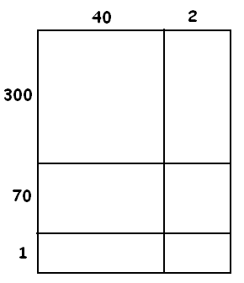
This picture computes 371 x 42 as
Select one term from each set of parentheses and collect all products.

Slide 12
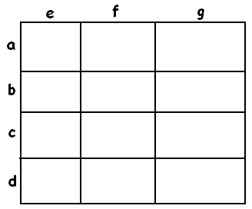
Question: What does this computation mean geometrically?
There will be twelve “pieces.”

Slide 13
Question: What is the “distributive law” usually taught in text books?
Question: How helpful is FOIL?
(Could we also OILF or LIFO or FLIO?)

Slide 14
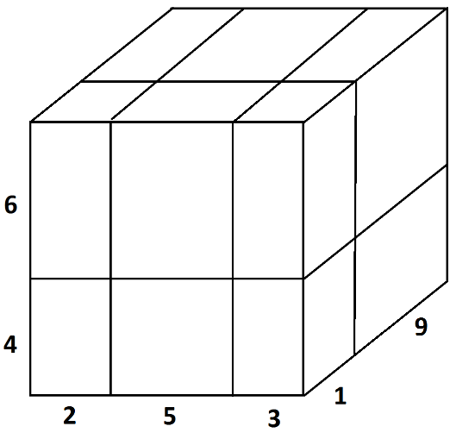
TAKING IT FURTHER
Can we match all 12 pieces?

Slide 16
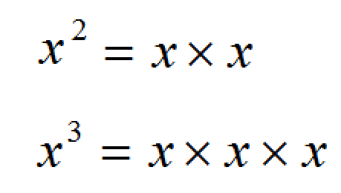
Have you noticed ….?
We have words for these.
We don’t have a word for this.

Slide 17
AN AGE-OLD QUESTION
Why is negative times negative positive?
2 x 3 =
3 + 3 = 6
-3 + -3 = -6
a x b = b x a
2 x (-3) =
3 x (-2) = -2 + -2 + -2 = -6
(-2) x 3 =
(-2) x (-3) =
????

Slide 18
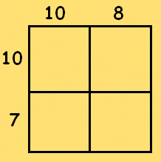
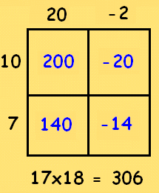
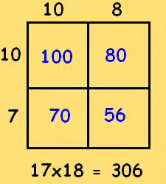
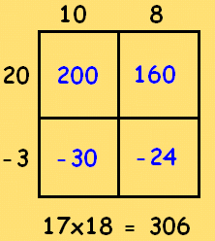
Age old question: Why is negative times negative positive?
Multiplication = Areas of rectangles.
Wild idea … Allow rectangles to have negative side lengths!
Consider 17x18

Slide 19
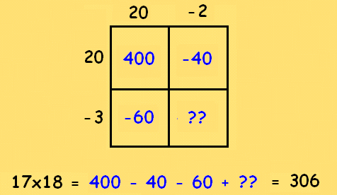
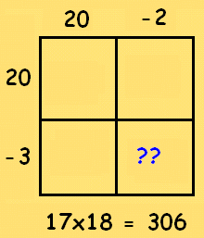
YOUR TURN:
What argument could you present to show that (-4) x (-5) must be +20?

Slide 21
Do you know …?

Slide 22
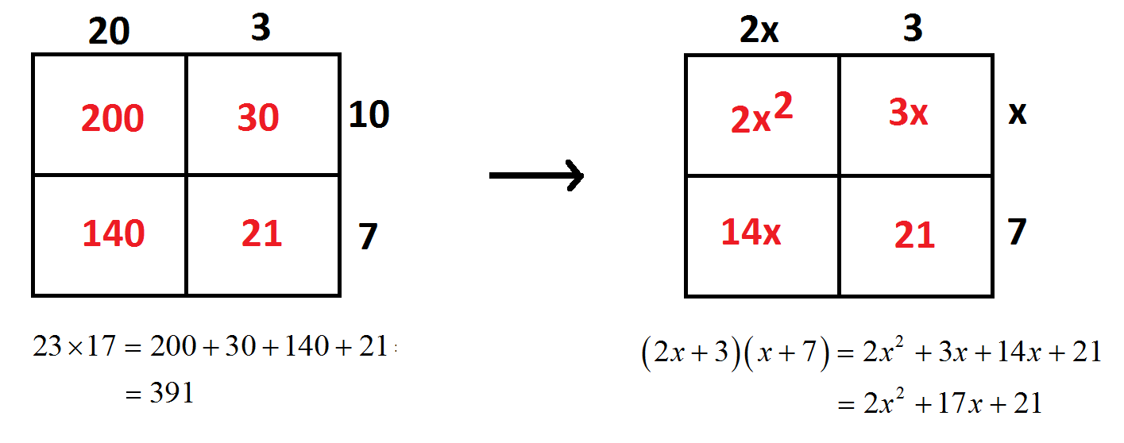
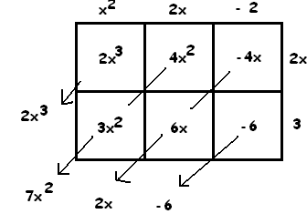
FROM NUMBERS, BASE 10,
TO POLYNOMIALS, BASE x.
And here is .

Slide 23
YOUR TURN:
Describe the picture that computes this product.
Is there an issue to contend with for this one?
What is a common student mistake in computing ?
Do you think the area model will help curb that mistake?

Slide 24
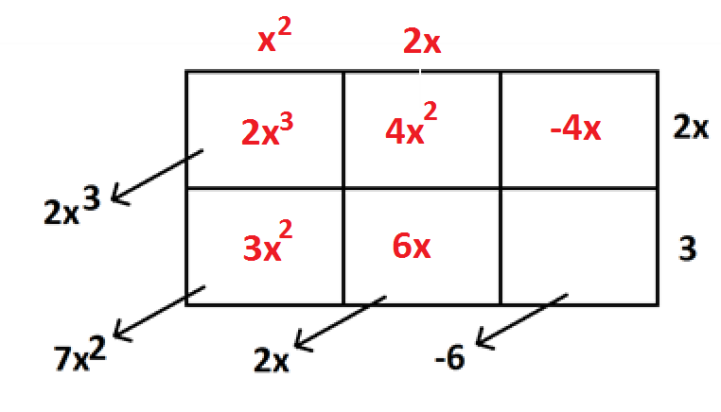
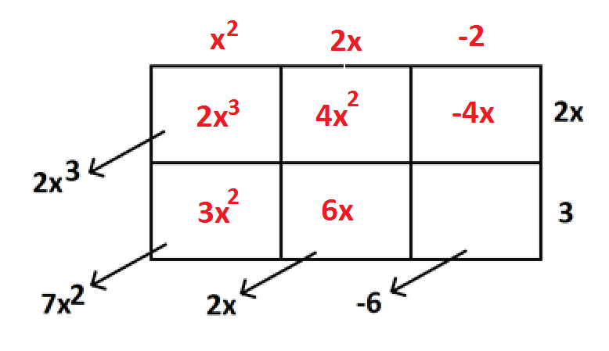
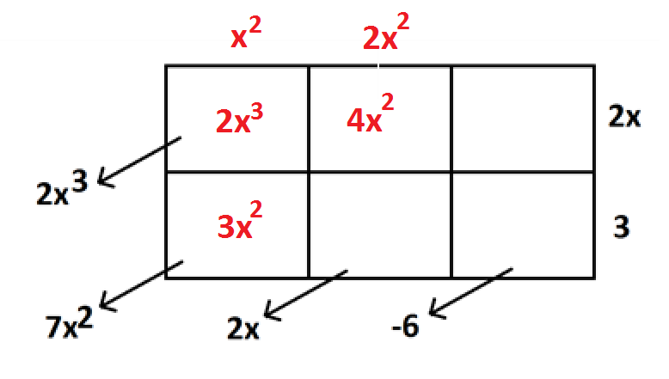
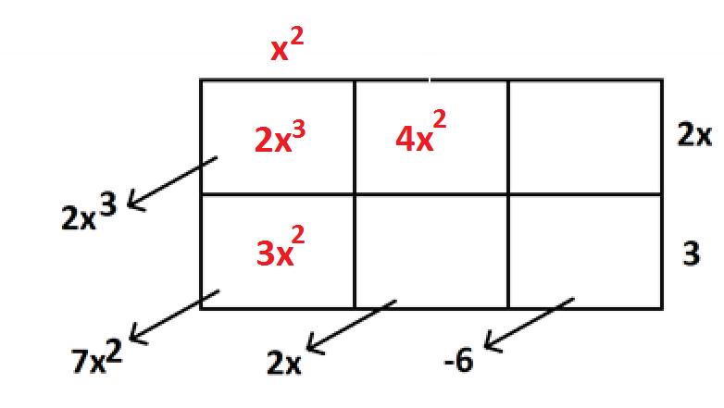
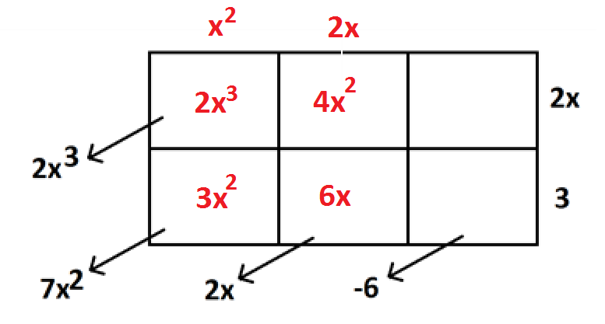
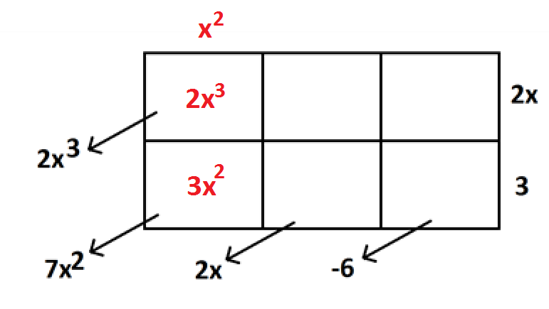
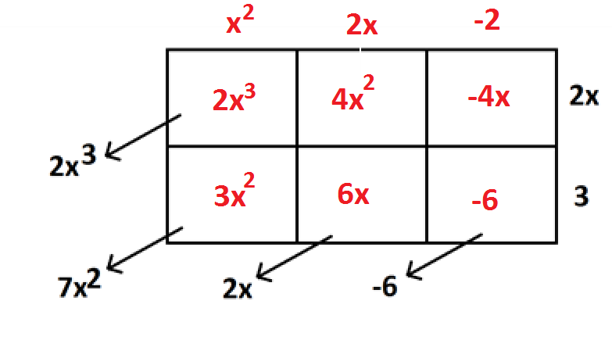
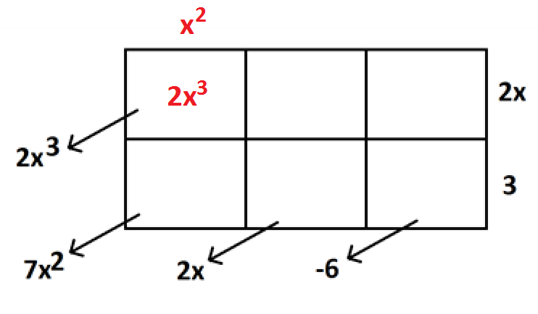
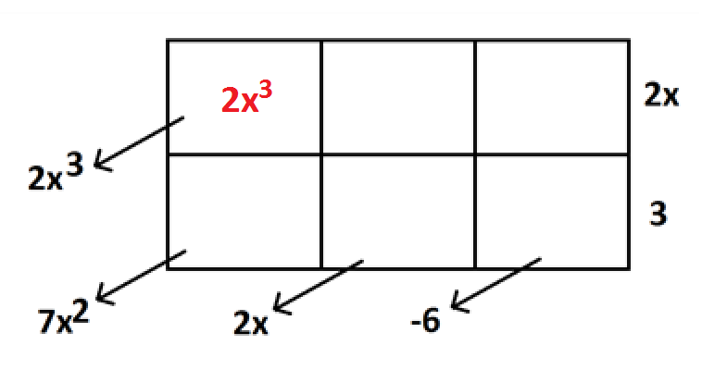
BACKWARDS! (aka DIVISION)

Slide 25
YOUR TURN:

Slide 26
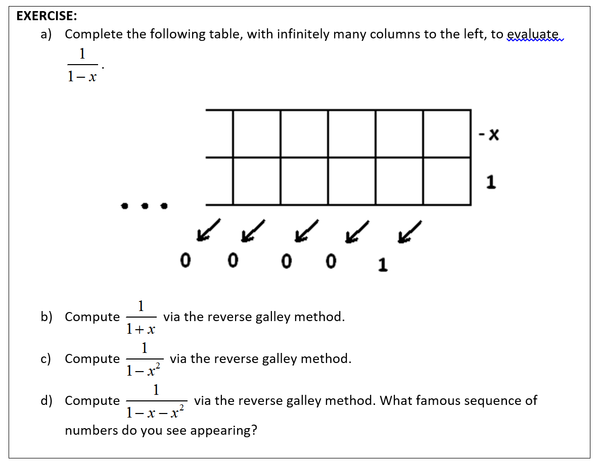
(Do you believe the geometric series formula?)

Slide 27
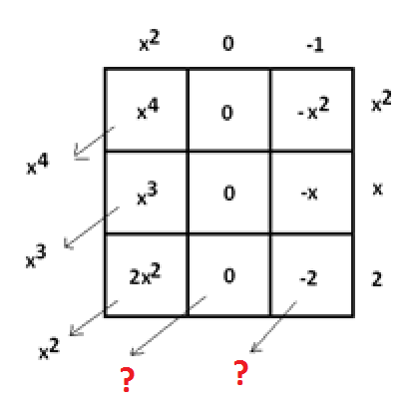
REMAINDERS
The area model shows that it wants the problem to be
to give

Slide 28
We don’t have
We have
What to do?
Make it what we want!

Slide 29
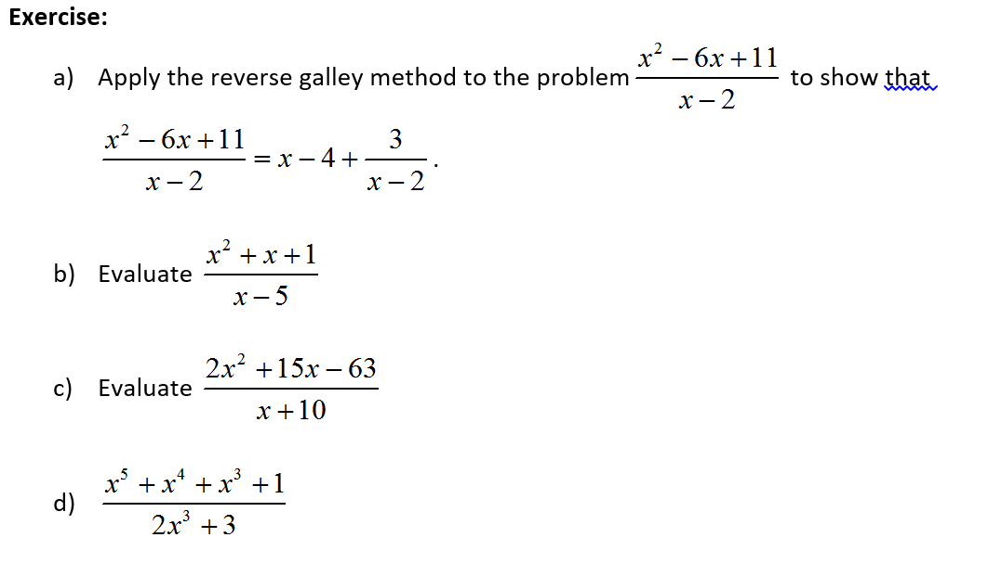
YOUR TURN:

Slide 30
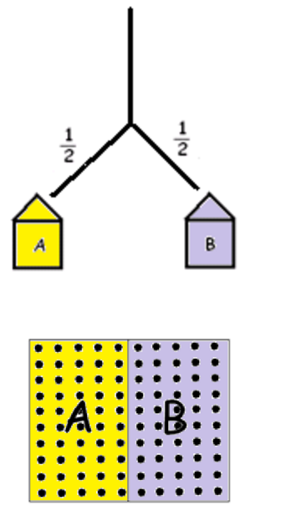
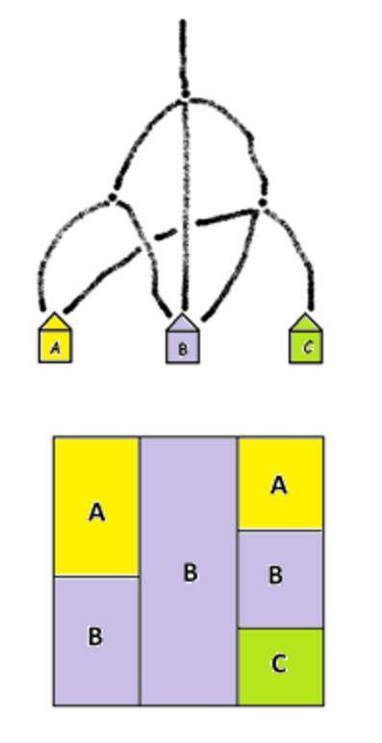
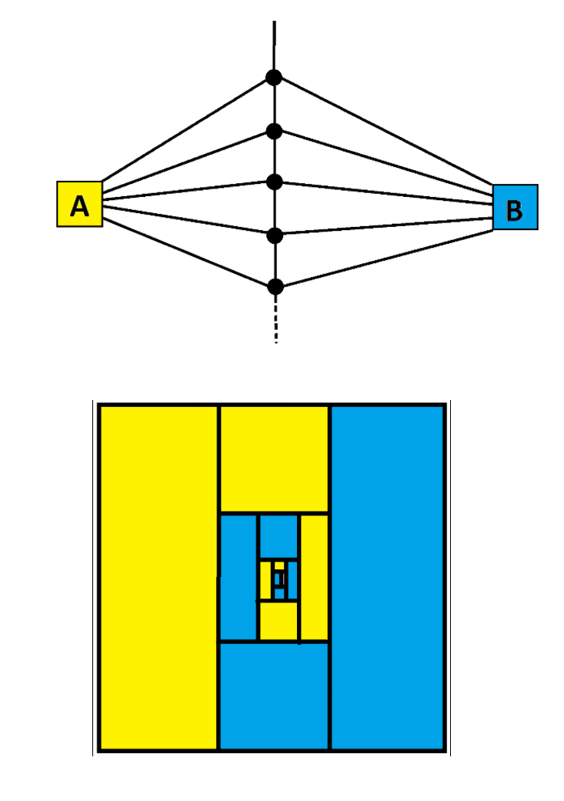
Another key application of the AREA MODEL
PROBABILITY THEORY
See the POWER OF MATHEMATICAL VISUALIZATION session.

Slide 31
THANKS!
JAMES TANTON
tanton.math@gmail.com
www.gdaymath.com
OTHER WEBSITES:
All my EARCOS 2017 PowerPoints appear here:
www.jamestanton.com.
Problem-Solving in the Classroom:
MAA’s CURRICULUM INSPIRATIONS
www.maa.org/ci
www.theglobalmathproject.org.

